Slide 1

Final Project
Being late to school
Completed: Abubakr , Muinjon
For : Mr. Shokirjon Shokirov

Slide 2


Why this problem ?
The most often problem in schools
Late students interrupt the lesson
Late students miss some main concepts of the lesson
Other punctual students can imitate them …
So , as a result students are taken under the worst moral and material punishments of school administration.
Our task : To help students not to be late !

Slide 3


Step 1 - Empathy. Interview with
students and teachers
Quantity : 12 - 13 students, 3 teachers
Interviewed : students and teachers of NEI “Pulatov`s school” and Lyceum #1 after M.Osimi

Slide 4




Step 1 - Empathy. Internet research
and own experience

Slide 5
Step 2 - Define. Analyzing all data
we have collected
Interview Online Research Experience
- Transportation - Woke-up late - Woke-up late
- Lack of motivation - Traffic hold up - Transportation
- Woke-up late - Long Distance - Lack of motivation
- Some tasks you have - In-Road circumstances - You have someone you have
to do before classes wait for…

Slide 6
Step 2 - Define. Focusing on a certain,
main cause of the problem
Interview Online Research Experience
- Transportation - Woke-up late - Woke-up late
- Lack of motivation - Traffic hold up - Transportation
- Woke-up late - Long Distance - Lack of motivation
- Some tasks you have - In-Road circumstances - You have someone you have
to do before classes wait for…

Slide 7
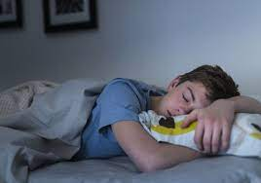
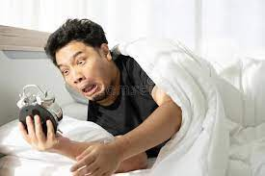
Step 2 - Define More about this
cause…
Actually , we can`t get up early when we sleep late
ِ
What makes us to sleep late ?

Slide 8
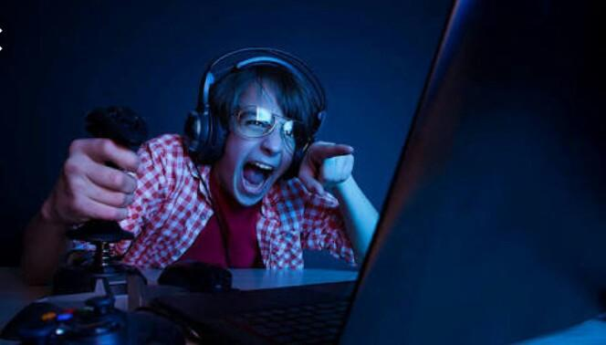
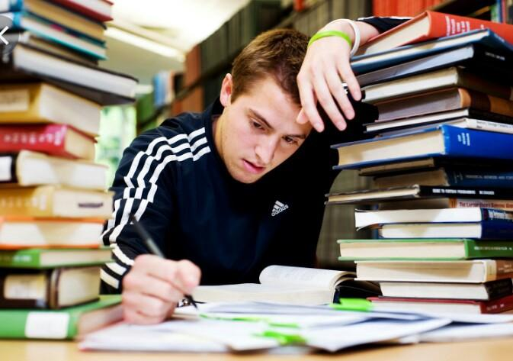
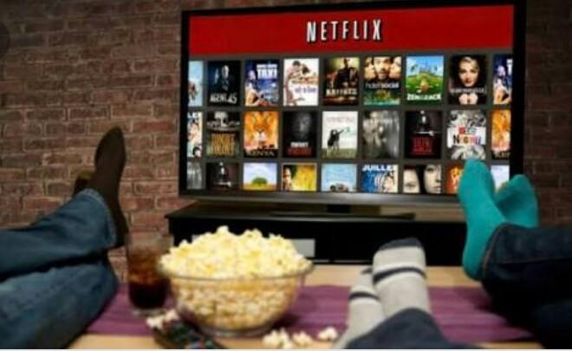
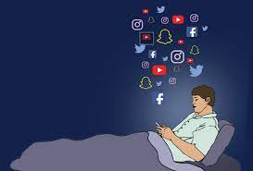
Step 2 - Define. Again the interview and
top 4 causes
Social Media
2. Online or video games
3. Movies or a football match
4. Too much paperwork or assignments

Slide 9
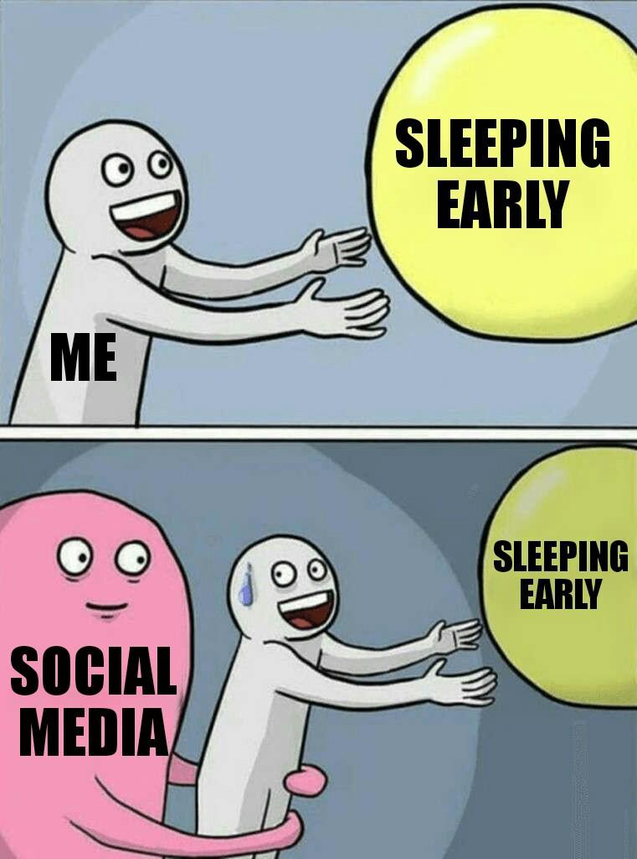


Step 2 - Define. Final aim - Social
Media and Games before sleeping

Slide 10
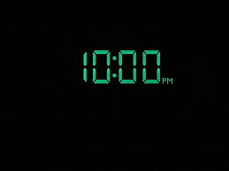


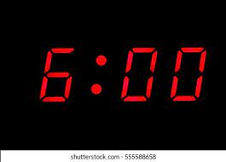


Step 3 - Ideate. Design of the solution
In order to wake up early you have to sleep about 7-8 hours. Actually , if you sleep at 10 pm chances that you will wake up at the time would be more. Although, a person gets into the bed at 10 pm , in this time he takes his phone and enters to the Social Media where and games he gets stuck till the midnight or until he falls asleep with a phone on the hands. So we have to limit their access to them at night .

Slide 11
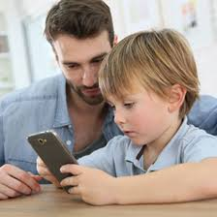

Step 3 – Ideate. How can we realize this strategy ? Our first idea
PARENTS CONTROL
OK , but …

Slide 12
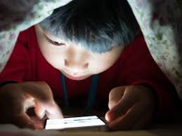
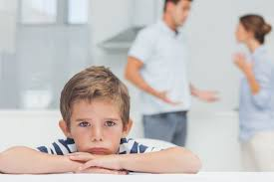
Step 3 – Ideate. Analyzing and finding the best solution
Disadvantages of the parent control:
A huge depression to the children
However they will find how to hide them
Taking the phone away is not a variant
Etc.

Slide 13
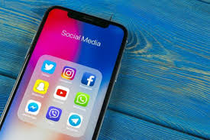
Step 3 – Ideate. Analyzing and finding the best solution
That is why we have to keep children from the games, social media during the night directly from the phone , so they wouldn`t have any interaction with anybody during this process . The phone should do this task itself

Slide 14







Step 4 – Prototype. How it would look like ?
As, we said the phone would do this task itself . And it will happen like this :

Slide 15

Step 5 – Test. Our interview and the feedbacks
Quantity : 5-6 students of our schools
Auditory : students we talked with in emphasize interview
Which bugs have we determined ?
Students hardly will download it
If the parents make them to download they just can delete it
What if you have to see something really important but it is already 10 pm
Interviewed students hesitate in realizing this project

Slide 16



Step 5 – Test. Improving our project based on the testing feedbacks
Problems & their Solutions
Students will hardly download it and if the parents do this they can just delete it during the night.
Before deleting , the app sends a message to the email of the students’ parents which was attached to the app while downloading . Our app can do this because it works in the background mode…

Slide 17


Step 5 – Test. Improving our project based on the testing feedbacks
Problems & their Solutions
2. What if you have something really important to see but it is already 10 pm ?
You can also get extra minutes in this times. Additional time is 10 minutes . You can use this time in such moments . Students can use this time although there is not something important but they have to memorize that after wasting the extra time there won’t be a chance anymore…

Slide 18


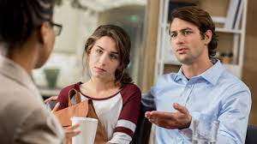


How are we going to implement our project ?
1. Cooperation with teachers and their recommendations to the students’ parents
2. Advertisement : posters and flyers

Slide 19

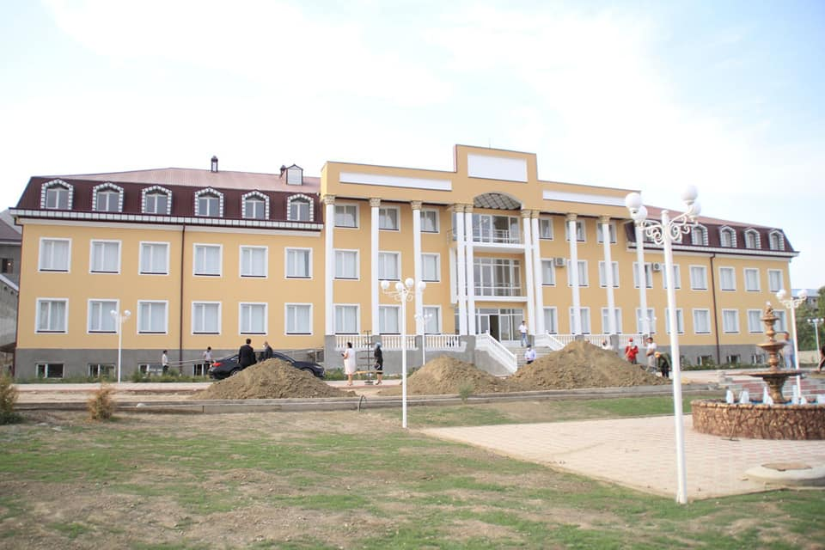
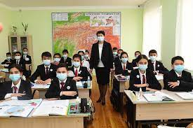
How many people are we going to impact by our project ? Our perspectives
School Class

Slide 20
Our project viability , feasibility , desirability
We believe in viability of our project because we think people especially parents need our product . Most of Tajik families are interested in education of their children and they are ready to do everything for this and our app will be desirable in this case.
Teachers will also have a big role in feasibility of our project . Their cooperation with our customers – parents is a very important aspect of our project’s feasibility In particular they are interested in our project too.
Conclusion : The problem we are to solve is very common and exciting for nowadays. That makes us to be sure in a success of our project !

Slide 21
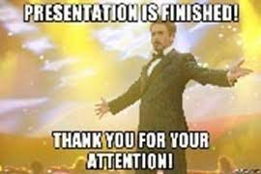
Thanks for attention !

Slide 22

